Slide 1
AFM Images

Slide 2
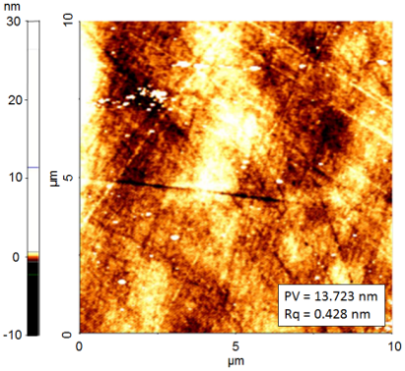
Unprocessed Sample

Slide 3
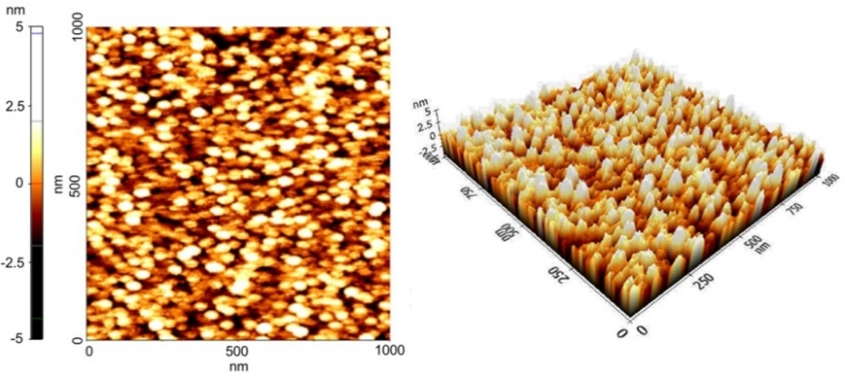
Nano-textured Sample

Slide 4
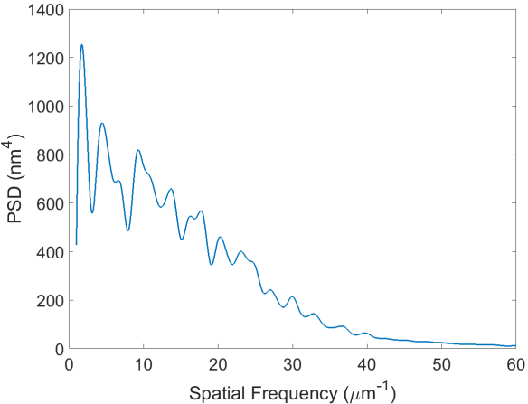
2D surface roughness PSD of nano-textured sample

Slide 5
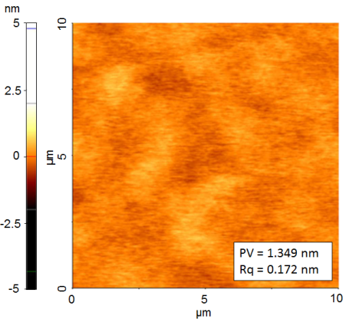
Angstrom-level Polished Sample

