Slide 1
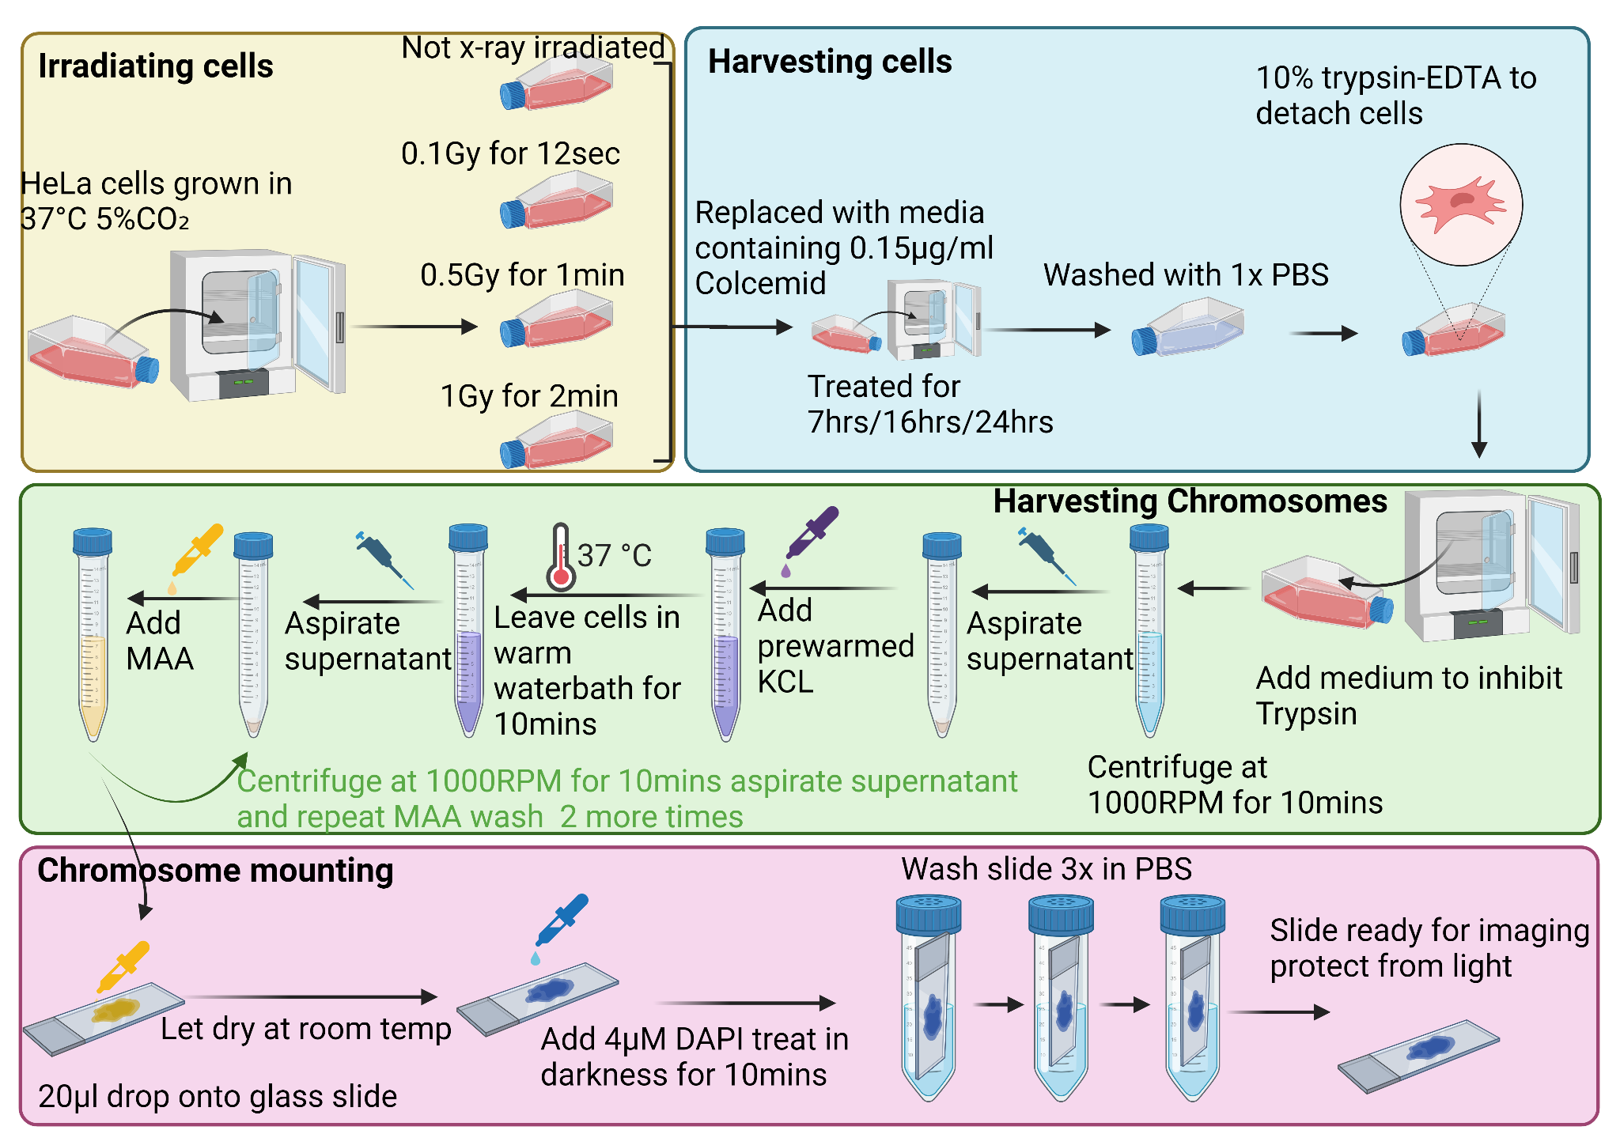
Figure 1. A. Flow diagram showing preparation of chromosomes including irradiation steps.

Slide 2
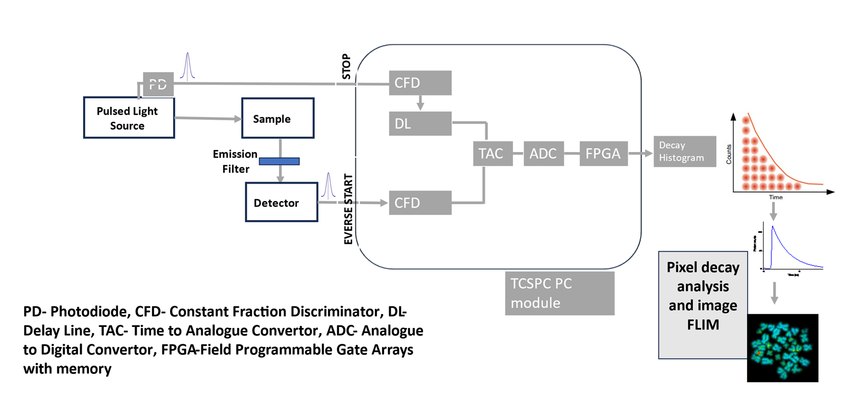
Figure 2. Schematic of multiphoton excitation FLIM with a confocal laser scanning microscopy setup. Sub-nanosecond excited state lifetime measurements using time-correlated single photon counting, TCSPC.
Notes:
Excitation sources for the multiphoton FLIM were from a Mira 900F (Ti-sapphire laser (Coherent Ltd., UK, Tunable 700-980 nm, pulse length 180- 200 fs) pumped by a Verdi V18, operating at 532 nm with a CW outputs. In this study, the laser was tuned to 760 nm. Photons were detected by a hybrid detector HPM 100-40, connected to a time correlated single photon counting PC module, SPC830 (Becker and Hickl). The data were then analysed using SPCImage that calculates the decay curve of the fluorophores and generates a lifetime value at each pixel of the image.

Slide 3
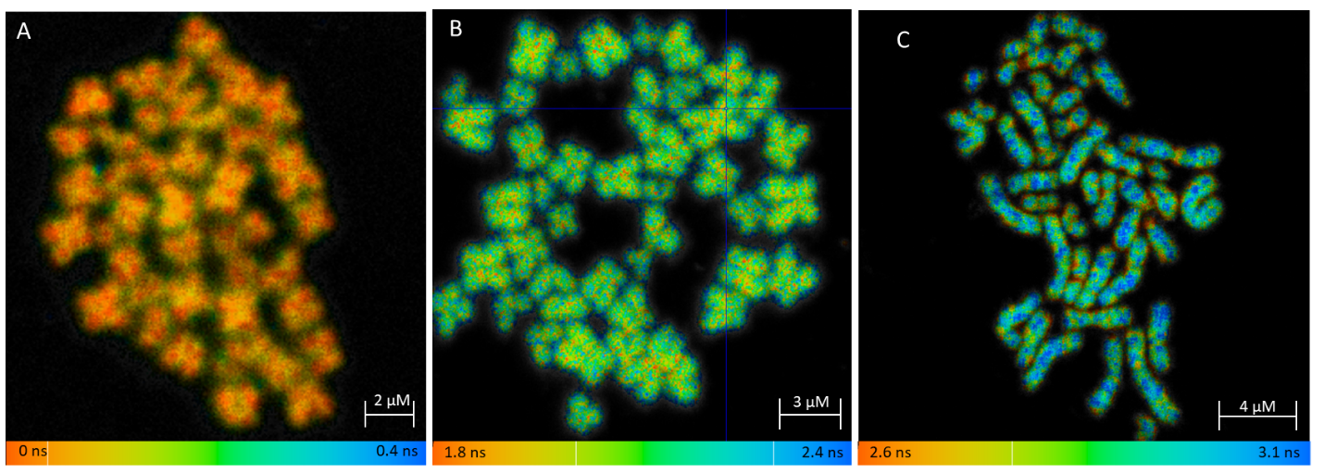
Table of lifetimes?
Figure 3. Comparison of different DNA fluorescence stains for fluorescence lifetime imaging microscopy of chromosomes. Comparison of FLIM T cell chromosome spreads stained with A) NucBlue B) Hoechst 33258 and C) DAPI and imaged using 405 nm FLIM excitation.
The fluorescent lifetime represented by the colour scales is displayed underneath each image A, B and C
A) NuncBlue resulted no arm/centromere lifetime difference
B) Hoechst resulted in a lifetime of 2.1 ns with no clear arm to centromere lifetime difference.
C) DAPI resulted in clear arm (3.1 ns) and centromere (2.6 ns) lifetime differences on individual chromosomes. 2 separate chromosomes are shown in the red and yellow box.

Slide 4
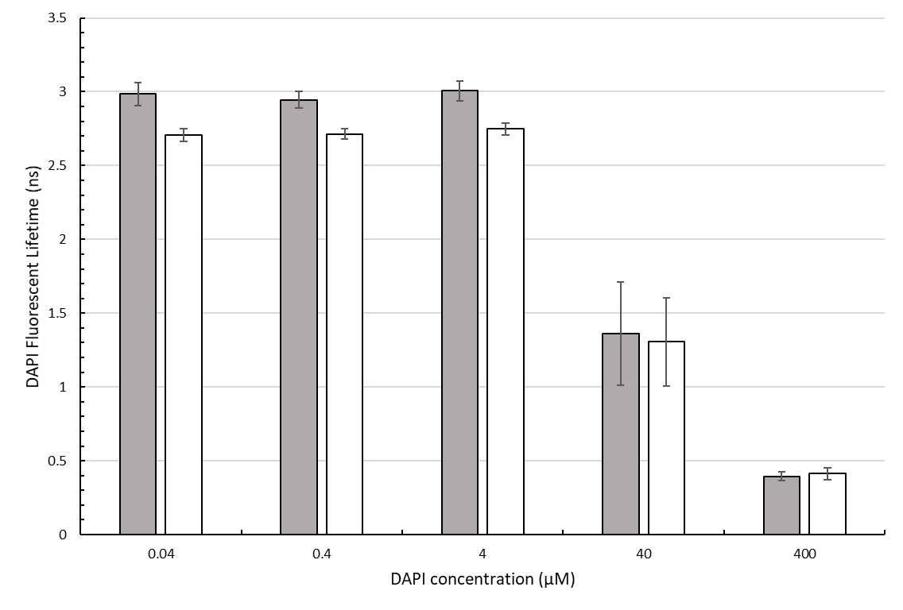
Figure 4: Clustered bar graph showing the effect of different DAPI concentrations on the DAPI fluorescence lifetime of human T cell chromosomes: Chromosomes were stained with different DAPI concentrations between 0.04 and 400 µM. With grey bars showing the fluorescent lifetime of the arms of chromosome 1 and white bars showing the fluorescent lifetime of the shorter heteromorphic region of chromosome 1. Error bars represent the standard deviation within each data set, with each bar calculated from 5 random pixels within each subregion, from 5 distinct chromosome spreads.

Slide 5
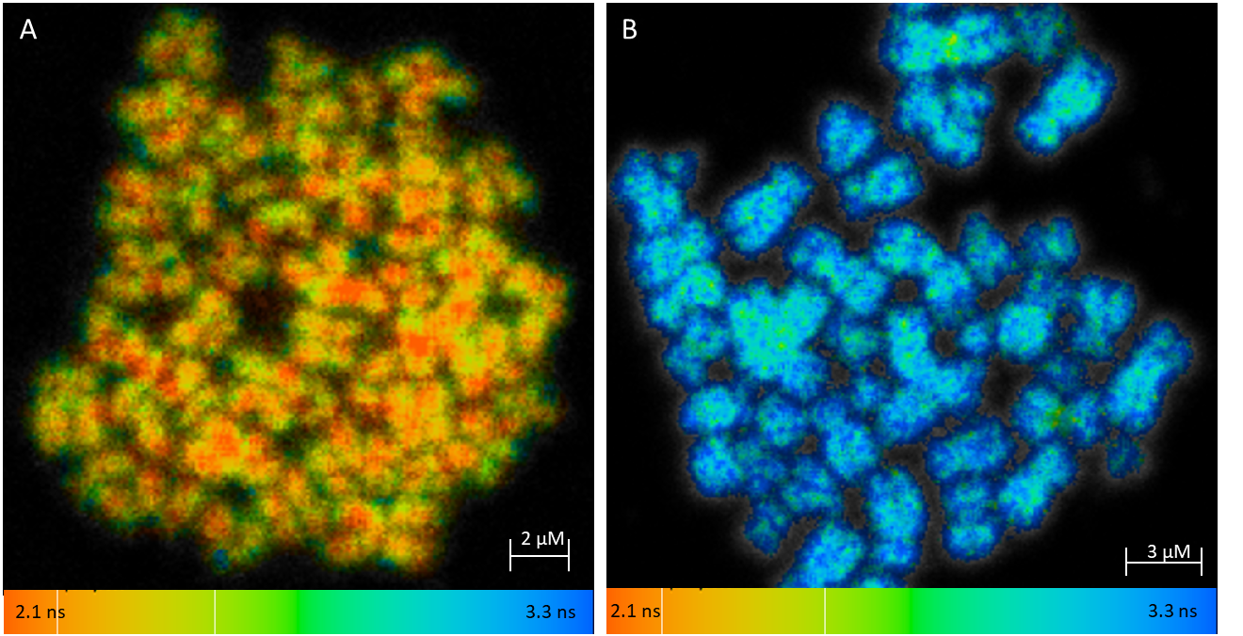
Bar graph with values
Also mention that difference can be seen
arrow to point to centromere
Figure 5. Methanol:acetic acid effect and interactions with chromosome labelled DAPI fluorescent lifetime. Chromosome preparation mounted onto slides, either partially (A) or fully (B) dried after MAA treatment and stained with 4 µM DAPI. Chromosome spreads were FLIM imaged using 405 nm excitation. The FLT is represented by the colour scales displayed underneath each image, with blue representing a longer fluorescent lifetime around 3 ns and orange representing a low fluorescent lifetime around 2.1 ns.

Slide 6
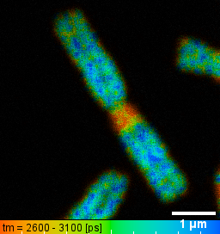
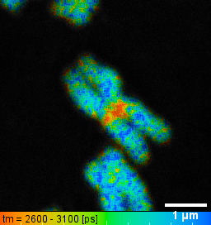
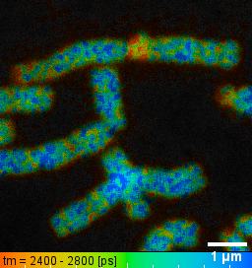
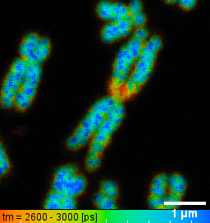
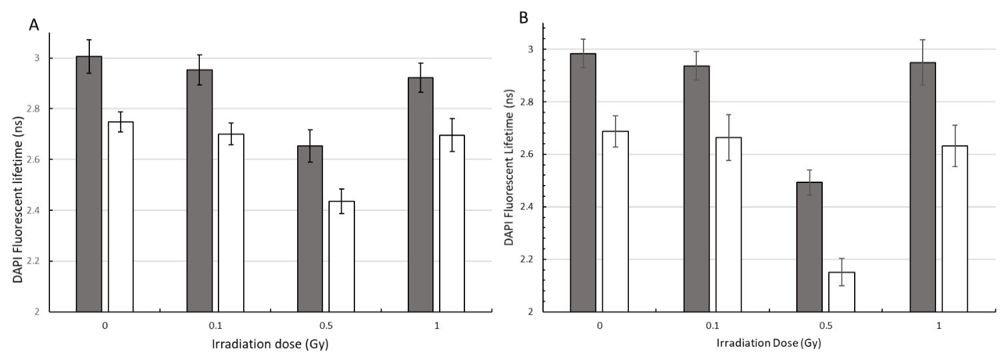
A
B
C
D
E
Figure 7. DAPI FLT of chromosomes after different x-ray irradiation doses. FLT images of HeLa human chromosome 1 after different irradiation doses A) 0, B) 0.1, C) 0.5 and D) 1 Gy irradiation. E) Clustered bar graph showing the DAPI fluorescence lifetime of irradiated HeLa metaphase chromosomes. Grey bars show the FLT of the chromosome 1 arms where as white bars show the FLT of the heteromorphic regions. 60x water objective was used to image 5 spreads. The chromosome one’s show a reduction in FLT when exposed to ionising irradiation with the shortest lifetimes measured at 0.5Gy and a FLT recovery at 1Gy.

Slide 7
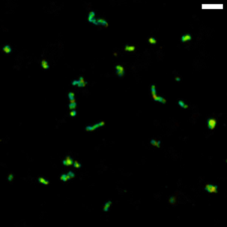
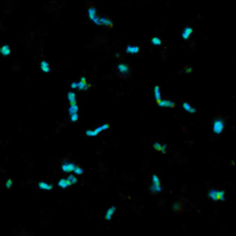
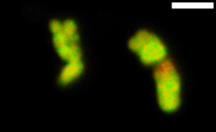
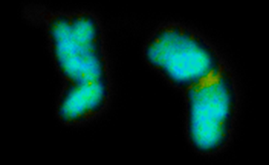
PA Buffer
EDTA_HEPES
A
B
2.8 ns
3.1 ns
C
D
2.7 ns
3.0 ns
Figure 8. Fluorescent Lifetime changes of ‘in-solution’ polyamine chromosomes. Pseudocolor images of DAPI lifetime in chromosomes after chromosome decondensation. In lower panel, DAPI lifetime increased from 2.5 ns to 2.8 ns in heteromorphic regions, and 2.7 ns to 3.0 ns in arm regions. Scale bars = 5 𝞵m (upper) and 2 𝞵m (lower).

Slide 8
Supplementary Material

Slide 9
A)
2 Sample T-test of equal variance
B)
Tukey HSD post-Hoc testing
Two-way ANOVA
C
(I) DAPI conc (uM) | (J) DAPI conc (uM) | Mean Difference (I-J) | Std. Error | Sig. | 95% Confidence Interval
 |  |  |  |  | Lower Bound | Upper Bound
0.04 uM | 0.4 uM | -0.004 | 0.03934 | 1 | -0.113 | 0.105
 | 4 uM | -0.04 | 0.03934 | 0.847 | -0.149 | 0.069
 | 40 uM | 1.40320* | 0.03934 | 0 | 1.2942 | 1.5122
 | 400 uM | 2.29600* | 0.03934 | 0 | 2.187 | 2.405
0.4 uM | 0.04 uM | 0.004 | 0.03934 | 1 | -0.105 | 0.113
 | 4 uM | -0.036 | 0.03934 | 0.891 | -0.145 | 0.073
 | 40 uM | 1.40720* | 0.03934 | 0 | 1.2982 | 1.5162
 | 400 uM | 2.30000* | 0.03934 | 0 | 2.191 | 2.409
4 uM | 0.04 uM | 0.04 | 0.03934 | 0.847 | -0.069 | 0.149
 | 0.4 uM | 0.036 | 0.03934 | 0.891 | -0.073 | 0.145
 | 40 uM | 1.44320* | 0.03934 | 0 | 1.3342 | 1.5522
 | 400 uM | 2.33600* | 0.03934 | 0 | 2.227 | 2.445
40 uM | 0.04 uM | -1.40320* | 0.03934 | 0 | -1.5122 | -1.2942
 | 0.4 uM | -1.40720* | 0.03934 | 0 | -1.5162 | -1.2982
 | 4 uM | -1.44320* | 0.03934 | 0 | -1.5522 | -1.3342
 | 400 uM | .89280* | 0.03934 | 0 | 0.7838 | 1.0018
400 uM | 0.04 uM | -2.29600* | 0.03934 | 0 | -2.405 | -2.187
 | 0.4 uM | -2.30000* | 0.03934 | 0 | -2.409 | -2.191
 | 4 uM | -2.33600* | 0.03934 | 0 | -2.445 | -2.227
 | 40 uM | -.89280* | 0.03934 | 0 | -1.0018 | -0.7838
DAPI concentration | p Values
0.04 µM | 4.11E-20
0.4 µM | 4.26E-22
4 µM | 1.8E-21
40 µM | 0.540957
400 µM | 0.085987
 | Sum of Squares | df | Mean Square | F | Sig.
Between Groups | 114.253 | 4 | 28.563 | 1476.381 | 0
Within Groups | 2.322 | 120 | 0.019
Total | 116.574 | 124
Supplementary figure 1: Statistical output for DAPI concentration fluorescence lifetime (FLT) comparison: Human T cells were prepared and mounted onto slides and were subjected to different DAPI concentrations ranging from 0.04 µM to 400 µM. FLT of the arms and hetromorphic regions of chromosome 1 was then determined using FLIM. In five different chromosome spreads, five random pixels within each region were selected and the mean FLT of each region calculated.
A) 2 Sample T-test of equal variance testing for differences in the FLT of the arms of centromeres of chromosome one, with a p-value of <0.05 suggesting a significant difference in FLT. B) Two-way ANOVA comparing the FLTs of the centromeric region at different DAPI concentrations (0.04 µM- 400 µM). Where a significance value of <0.05 suggests there is a difference between at least two of the DAPI concentrations. C) Tukeys HSD Post Hoc test to compare DAPI concentrations centromeric FLT against each other to test for significance between group comparisons. Where a significance value of <0.05 for a group comparison suggests there is a significance difference in the centromeric FLT at those DAPI concentrations.

Slide 10
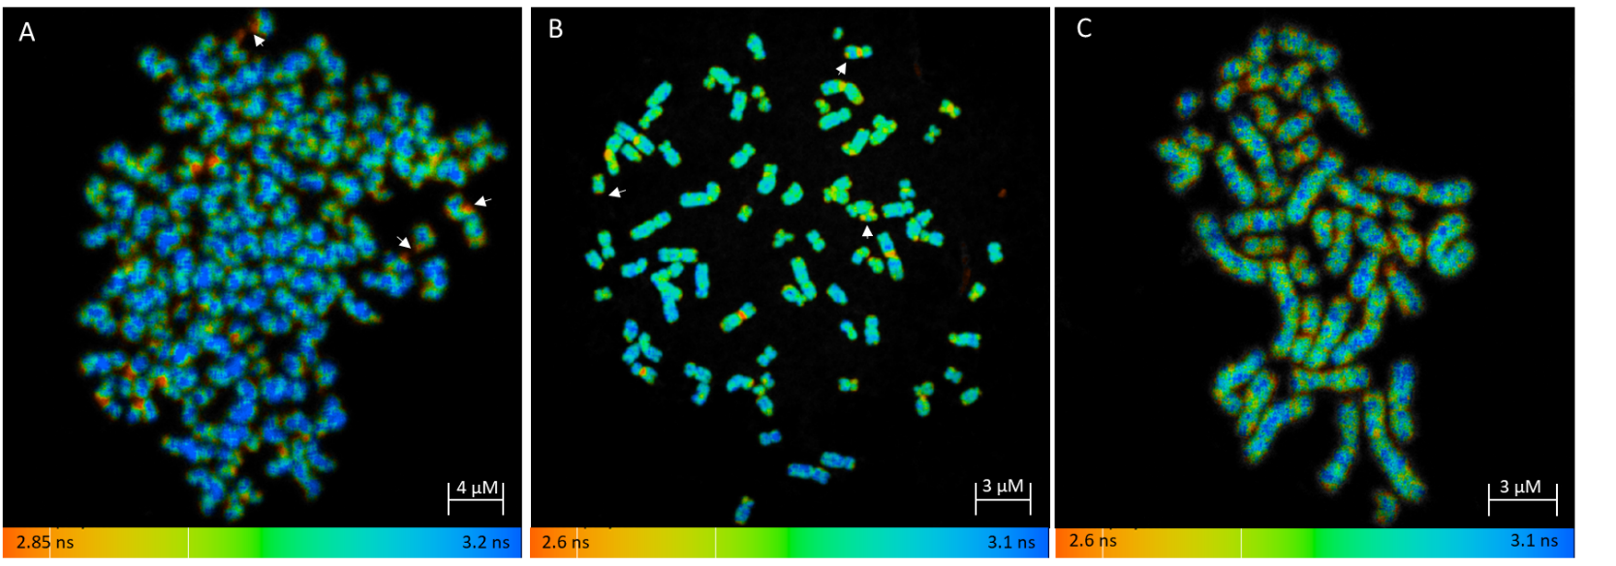
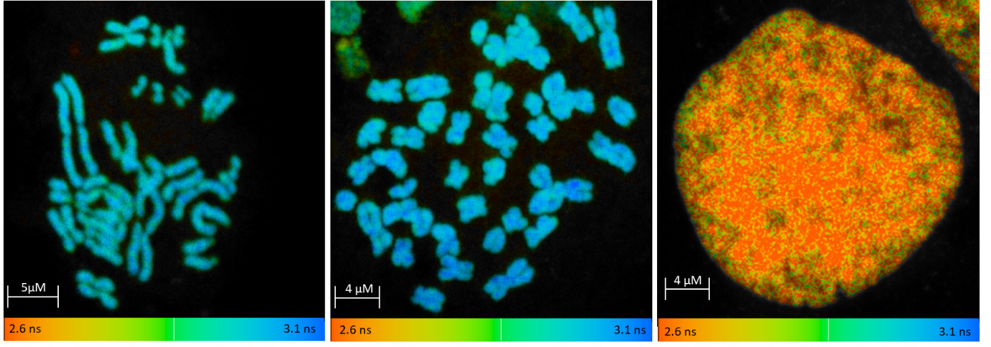
D
E
Supplementary figure 2: FLIM images showing metaphase chromosome spreads from different human and non-human cell lines. Chromosomes were stained with 4 µM DAPI. With the cell lines used: A) HEK293T, B) HeLa, C) T cells, D) CHO cells and E) Gerbil Spleen cells. FLT is displayed using a false-colour scale bar. White arrows show examples of chromosomal aberrations. F) 2-sample T test showing differences in the FLT between the arms and heteromorphic regions of different human and non-human cell lines. Where a significance of <0.05 suggests there is a significant difference in the FLT of the arms and heteromorphic region. All human cell lines (A-C) show a decrease in FLT at the heteromorphic region of specific chromosomes within spreads, while no difference is seen in non-human cell lines (D-E).
F)
Cell Line | p Value
HEK293T | 6.78E-18
HeLa | 7.46E-23
T cells | 1.8E-21
CHO | 0.43791
Gerbil Spleen | 0.980812
E
F
Table of lifetimes? What are the average lifetimes, assuming we did follow the correct protocol here
Notes:
Figure 14 Fluorescent Lifetime Microscopy images showing metaphase chromosome spreads from different human and animal cell lines: Chromosome spreads were prepared following an 16 hour colcemid arresting cells at metaphase, after which they underwent a KCl hypotonic treatment and fixation using MAA. Cells were then mounted onto humidified slides from a height of 30 cm’s, and stained with 4 µM fresh DAPI. With the cell lines used: (A) HEK293T, (B) HeLa,(C) T cells, (D) CHO cells and (E) Gerbil Spleen cells . Fluorescent lifetime (ns) is displayed using a false-colour scale, with red representing a short fluorescent lifetime and blue representing a longer fluorescent lifetime. All human cell lines (A-C) show a decrease in fluorescent lifetime at the centromeric region of specific chromosomes within spreads, while no difference is seen in non-human cell lines (D-E). White arrows show examples of chromosomal aberrations.

Slide 11
A)
2 Sample T-test of equal variance
B)
Tukey HSD post-Hoc testing
Two-way ANOVA
C
Irradiation dose | p Values
control | 7.46289E-23
0.1 Gy | 9.94009E-18
0.5 Gy | 1.60048E-28
1 Gy | 4.61642E-18
 | Sum of Squares | df | Mean Square | F | Sig.
Between Groups | 4.918 | 3 | 1.639 | 327.67 | 0
Within Groups | 0.48 | 96 | 0.005
Total | 5.398 | 99
(I) HeLa Condition (Gy) | (J) HeLa Condition (Gy) | Mean Difference (I-J) | Std. Error | Sig. | 95% Confidence Interval
 |  |  |  |  | Lower Bound | Upper Bound
Control | 0.1 Gy | 0.0236 | 0.02001 | 0.641 | -0.0287 | 0.0759
 | 0.5 Gy | .53640* | 0.02001 | 0 | 0.4841 | 0.5887
 | 1 Gy | .05520* | 0.02001 | 0.034 | 0.0029 | 0.1075
0.1 Gy | Control | -0.0236 | 0.02001 | 0.641 | -0.0759 | 0.0287
 | 0.5 Gy | .51280* | 0.02001 | 0 | 0.4605 | 0.5651
 | 1 Gy | 0.0316 | 0.02001 | 0.395 | -0.0207 | 0.0839
0.5 Gy | Control | -.53640* | 0.02001 | 0 | -0.5887 | -0.4841
 | 0.1 Gy | -.51280* | 0.02001 | 0 | -0.5651 | -0.4605
 | 1 Gy | -.48120* | 0.02001 | 0 | -0.5335 | -0.4289
1 Gy | Control | -.05520* | 0.02001 | 0.034 | -0.1075 | -0.0029
 | 0.1 Gy | -0.0316 | 0.02001 | 0.395 | -0.0839 | 0.0207
 | 0.5 Gy | .48120* | 0.02001 | 0 | 0.4289 | 0.5335
Supplementary Figure 3: Statistical output for different ionising radiation doses on the fluorescent lifetime of HeLa: HeLa cells were irradiated at different doses of ionising radiation ranging from 0 Gy to 1 Gy. From these irradiated cells, chromosomes were prepared and mounted onto slides and stained with 4 µM of DAPI. Fluorescent lifetime (FLT) of the arms and centromere of metaphase chromosome one was then determined using FLIM. In five different chromosome spreads, five random pixels within each region were selected and the mean FLT of each region calculated. A) 2 Sample T-test of equal variance testing for differences in the FLT of the arms of centromeres of chromosome one, with a p-value of <0.05 suggesting a significant difference in FLT. B) Two-way ANOVA comparing the FLTs of the centromeric region at different irradiation doses (0 Gy - 1 Gy). Where a significance value of <0.05 suggests there is a difference between at least two of the irradiation doses. C) Tukeys HSD Post Hoc test to compare irradiation doses centromeric FLT against each other to test for significance between group comparisons. Where a significance value of <0.05 for a group comparison suggests there is a significance difference in the centromeric FLT at those irradiation doses.

Slide 12
A)
2 Sample T-test of equal variance
C
Tukey HSD post-Hoc testing
 | (I) T cell Irradiation Dose (Gy) | (J) T cell Irradiation Dose (Gy) | Mean Difference (I-J) | Std. Error | Sig. | 95% Confidence Interval
 |  |  |  |  |  | Lower Bound | Upper Bound
Tukey HSD | Control | 0.1 Gy | .048000* | 0.014081 | 0.005 | 0.01118 | 0.08482
 |  | 0.5 Gy | .312400* | 0.014081 | 0 | 0.27558 | 0.34922
 |  | 1 Gy | .052520* | 0.014081 | 0.002 | 0.0157 | 0.08934
 | 0.1 Gy | Control | -.048000* | 0.014081 | 0.005 | -0.08482 | -0.01118
 |  | 0.5 Gy | .264400* | 0.014081 | 0 | 0.22758 | 0.30122
 |  | 1 Gy | 0.00452 | 0.014081 | 0.988 | -0.0323 | 0.04134
 | 0.5 Gy | Control | -.312400* | 0.014081 | 0 | -0.34922 | -0.27558
 |  | 0.1 Gy | -.264400* | 0.014081 | 0 | -0.30122 | -0.22758
 |  | 1 Gy | -.259880* | 0.014081 | 0 | -0.2967 | -0.22306
 | 1 Gy | Control | -.052520* | 0.014081 | 0.002 | -0.08934 | -0.0157
 |  | 0.1 Gy | -0.00452 | 0.014081 | 0.988 | -0.04134 | 0.0323
 |  | 0.5 Gy | .259880* | 0.014081 | 0 | 0.22306 | 0.2967
Irradiation dose | p Values
Control | 1.801E-21
0.1 Gy | 4.4902E-22
0.5 Gy | 3.2318E-18
1 Gy | 1.8137E-17
B)
Two-way ANOVA
 | Sum of Squares | df | Mean Square | F | Sig.
Between Groups | 1.501 | 3 | 0.5 | 201.837 | 0
Within Groups | 0.238 | 96 | 0.002
Total | 1.739 | 99
Supplementary Figure 4: Statistical output for different ionising radiation doses on the FLT of T cells: Human T cells were irradiated at different doses of ionising radiation ranging from 0 Gy to 1 Gy. From these irradiated cells, chromosomes were prepared and mounted onto slides and stained with 4 µM of DAPI. FLT of the arms and heteromorphic region of chromosome one was then determined using FLIM. In five different chromosome spreads, five random pixels within each region were selected and the mean FLT of each region calculated. A) 2 Sample T-test of equal variance testing for differences in the FLT of the arms of centromeres of chromosome one, with a p-value of <0.05 suggesting a significant difference in FLT. B) Two-way ANOVA comparing the FLTs of the centromeric region at different irradiation doses (0 Gy - 1 Gy). Where a significance value of <0.05 suggests there is a difference between at least two of the irradiation doses. C) Tukeys HSD Post Hoc test to compare irradiation doses centromeric FLT against each other to test for significance between group comparisons. Where a significance value of <0.05 for a group comparison suggests there is a significance difference in the centromeric FLT at those irradiation doses.

Slide 13
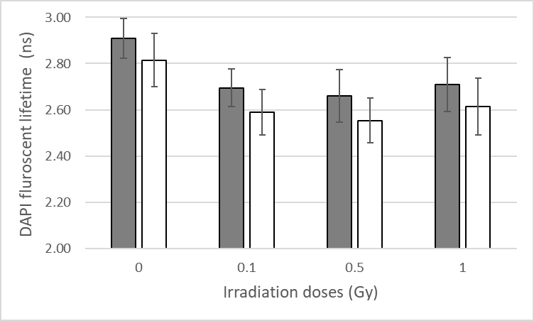
A
B
Supplementary figure 5. Represent DAPI FLT change of T cell chromosome 1’s after different x-ray irradiation doses. A) Improved sample preparation (chromosome spreads n=5) and B) random sample preparation (chromosome spreads n = 9). 60x water objective was used for A and B.. Grey bars show the FLT of the chromosome 1 arms where as white bars show the FLT of the shorter heteromorphic regions of chromosome. Error bar represent standard deviation.

Slide 14
 |  | Fluorescence Lifetime (ns)
Condition | Cell type | Chromosome Arm | Heteromorphic region | Figures
NucBlue | HeLa | 0-0.1 | none | Figure 3A
Hoechst 33258 | HeLa | 2.1 | none | Figure 3B
0.04-4 µM DAPI | Human T cells | 3.1 - 3.2 | 2.6 - 2.7 | Figure 3C and Figure 4
40 µM DAPI | Human T cells | 1- 1.5 | 1- 1.4 | Figure 4
400 µM DAPI | Human T cells | 0.4 | 0.4 | Figure 4
Wet Methanol Acetic Acid | Human T cells | 2.1 | none | Figure 5A
Dried Methanol Acetic Acid | Human T cells | 3 | 2.7 | Figure 5B
Wet Coverslip | HeLa | 3.1-3.3 | 2.8-2.9 | Figure 6A
Dried Coverslip | HeLa | 2.9-3.0 | 2.7 | Figure 6B
0 Gy ionising radiation | HeLa | 3.0 - 3.1 | 2.6 - 2.7 | Figure 7A and E
0.1 Gy ionising radiation | HeLa | 2.9 - 3.0 | 2.6 - 2.7 | Figure 7B and E
0.5 Gy ionising radiation | HeLa | 2.4 - 2.5 | 2.1 - 2.2 | Figure 7C and E
1 Gy ionising radiation | HeLa | 2.8 - 3.0 | 2.6 - 2.7 | Figure 7D and E
0 Gy ionising radiation | Human T cells | 3.0 - 3.1 | 2.7 - 2.8 | Supplementary Figure 5A
0.1 Gy ionising radiation | Human T cells | 2.9 - 3 | 2.7 | Supplementary Figure 5A
0.5 Gy ionising radiation | Human T cells | 2.6 - 2.7 | 2.4 - 2.5 | Supplementary Figure 5A
1 Gy ionising radiation | Human T cells | 2.9 - 3.0 | 2.6 - 2.7 | Supplementary Figure 5A
PA chromosome condensed | HeLA | 2.7 | 2.5 | Figure 8C
PA chromosome decondensed | HeLA | 3.1 | 2.8 | Figure 8D
Supplementary figure 6. Summary of FLT for different chromosome preparation conditions.

